Slide 1
MUSE
a csci-201 project

Slide 2
APP HEADER
OPTION 1
Key: A Major
Style: Baroque
Other details:
Things
stuff
OPTION 2
OPTION 3
Selected
Select
Select
Now Playing: Option 1

Slide 3
APP HEADER
OPTION 1
Key: A Major
Style: Baroque
Other details:
Things
stuff
OPTION 2
OPTION 3
Selected
Select
Select
Now Playing: Option 1

Slide 4
MUSE
a csci-201 project

Slide 6
muse
ai generated music

Slide 7
begin
1
Create a Melody
MIDI
Sing
Import
2
Customize Accompaniment
Key: Tempo:
Style: Mood:

Slide 8
begin
1
Create a Melody
Create
Share
Settings
MIDI
Sing
Import
2
Customize Accompaniment
Key: Tempo:
Style: Mood:

Slide 10
muse
ai generated music

Slide 11
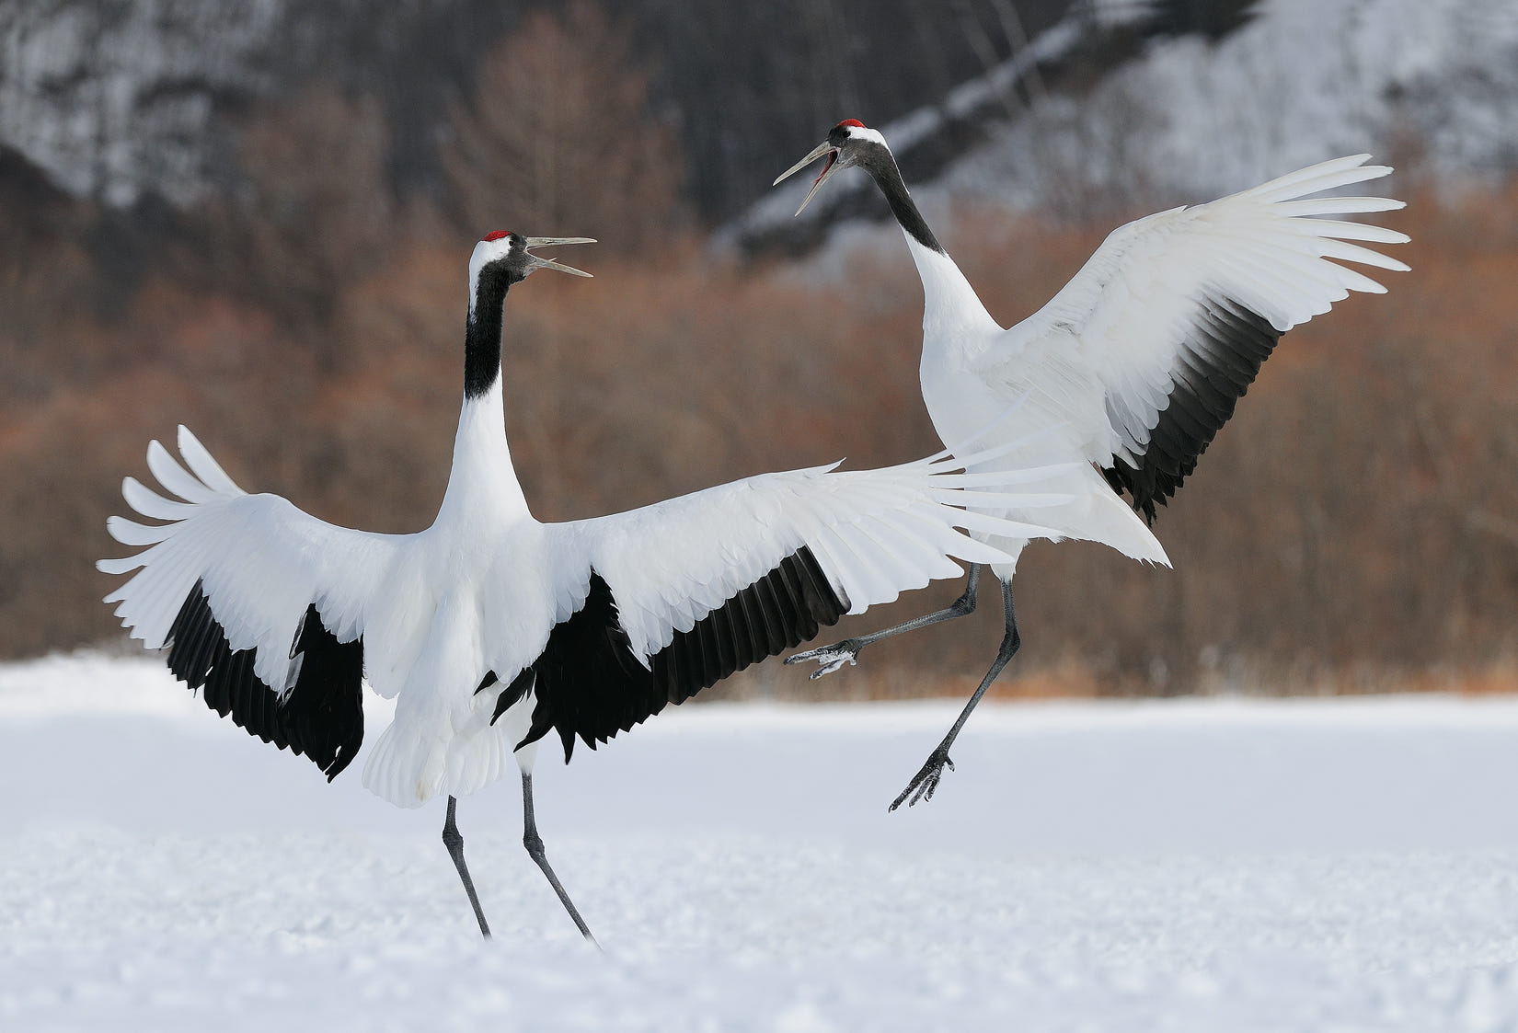
Create
username
Create
Share
Browse
settings

Slide 12
you
search…
username
NEW SONG
Song 1
Create
Share
Select
Browse
Song 2
Song 3
Select
Select
Song 4
Song 5
Select
Select
settings

